Slide 1
VASCULAR BIOLOGY OF ATHEROSCHLEROSIS
Dr.Govind S M K

Slide 2
Atherosclerosis- An epidemic of 21st century
• Economic development and urbanization promoted habits of poor diet (e.g., a surfeit of saturated fats) and diminished physical activity, which can favor atherogenesis.

Slide 3
Atherosclerosis is characterized by intimal lesions called ATHEROMAs(also called atheromatous or atherosclerotic plaques) that protrude into vessel lumens.
Besides mechanically obstructing blood flow,
1.Atherosclerotic plaques can rupture- thrombosis;
2.plaques also weaken the underlying media -aneurysm .

Slide 4
An atheromatous plaque consists of a raised lesion with a soft, yellow, grumous core of lipid (mainly cholesterol and cholesterol esters) covered by a white fibrous cap.

Slide 5
The temporal presentation of atherosclerosis
- native CAD, which develops over decades
- vein graft atherosclerosis and in-stent neoatherosclerosis-within months to a few years.
Atherosclerosis- Heterogeneity in time;
Chronic and acute manifestations.
Many young people have abnormal thickening of the coronary arterial intima; yet typically, symptoms of atherosclerosis emerge only after several decades of delay.

Slide 6
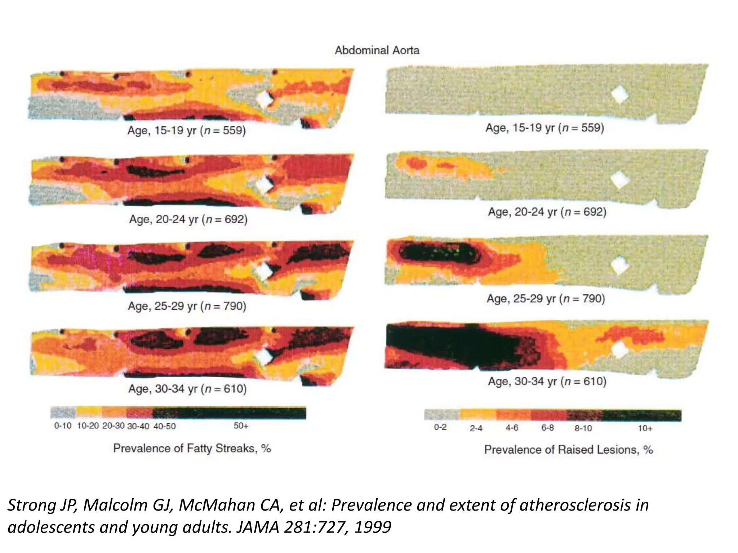

Slide 7
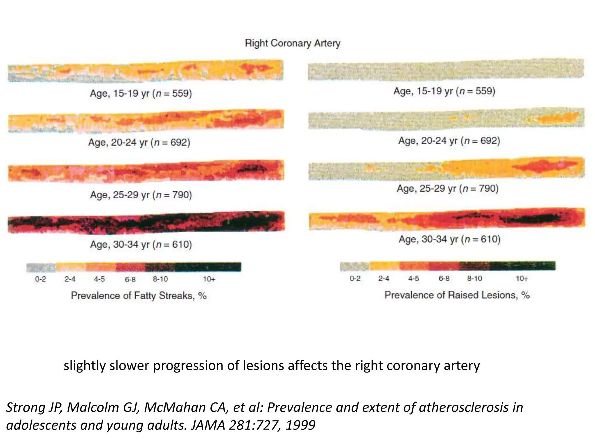

Slide 8
HISTORY
• 1970- Russell Ross- SMC proliferation in response to injury to arterial wall.
• 1990- libby and co- complex interaction between risk factors and inflammation
• 1990- Fuster and co- plaque progression a staged event(endothelium- intima-media)
• Deep plaque fissures and ulcerations were identified as cause of luminal thrombosis and clinical presentation of ACS.

Slide 11
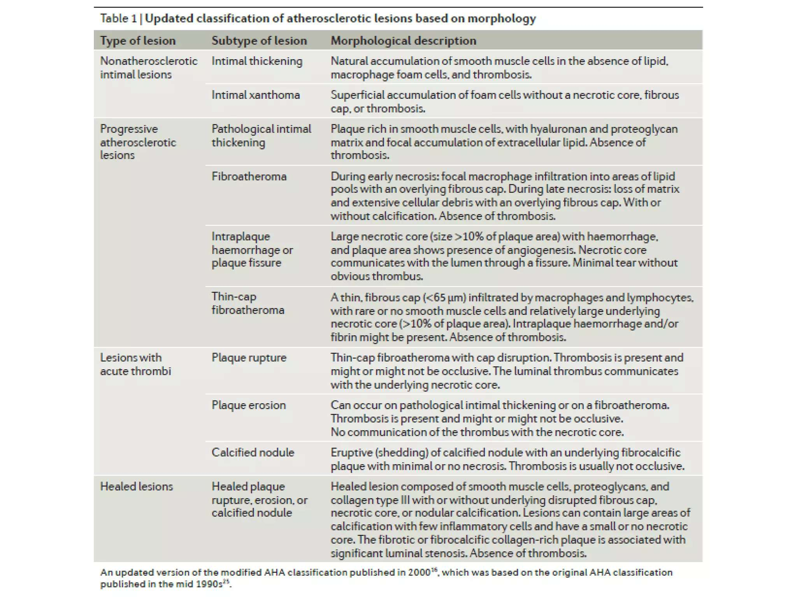

Slide 12
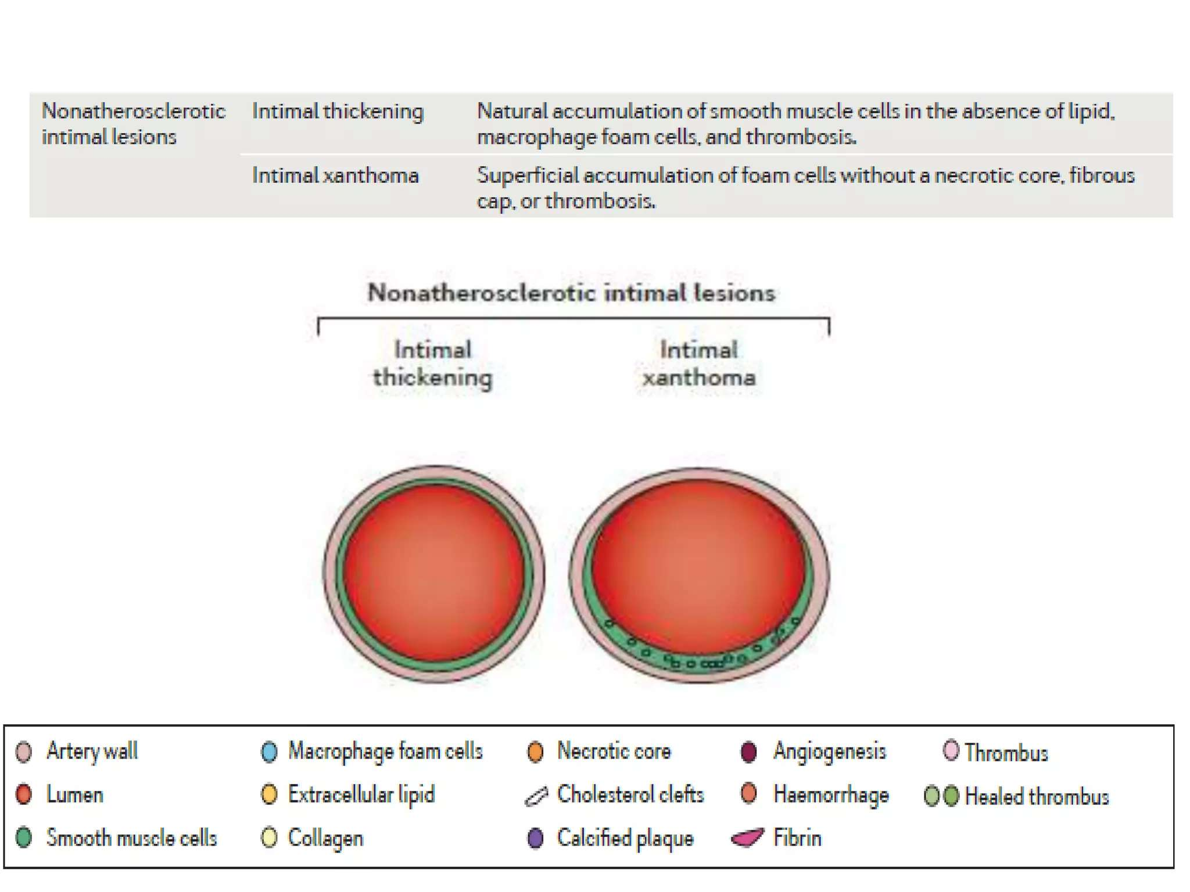

Slide 13
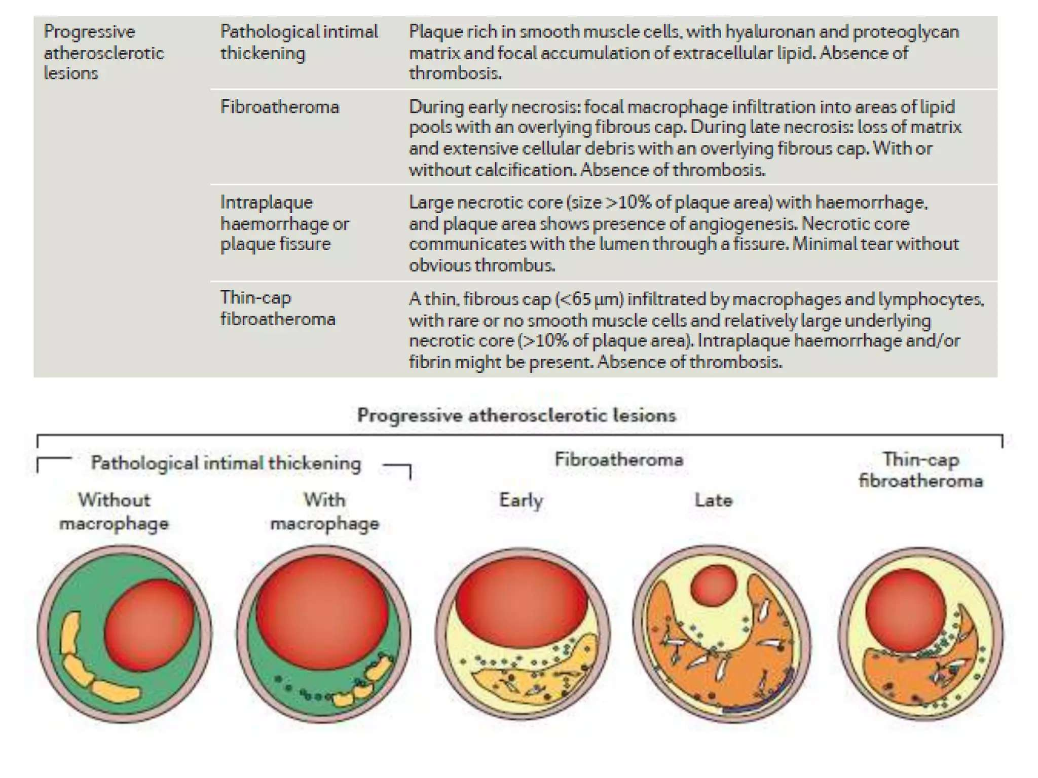

Slide 14
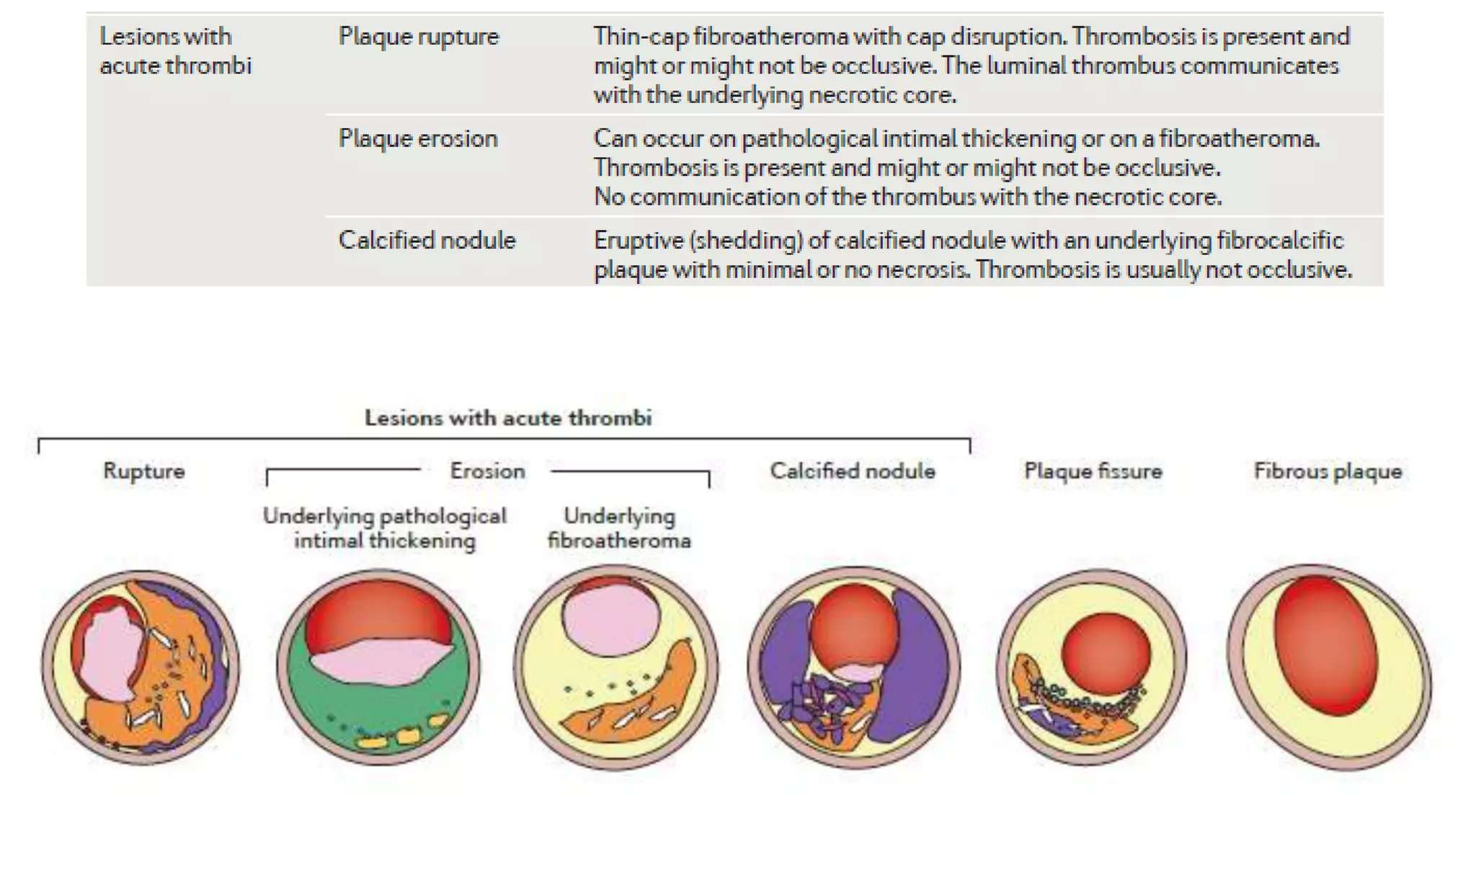

Slide 15
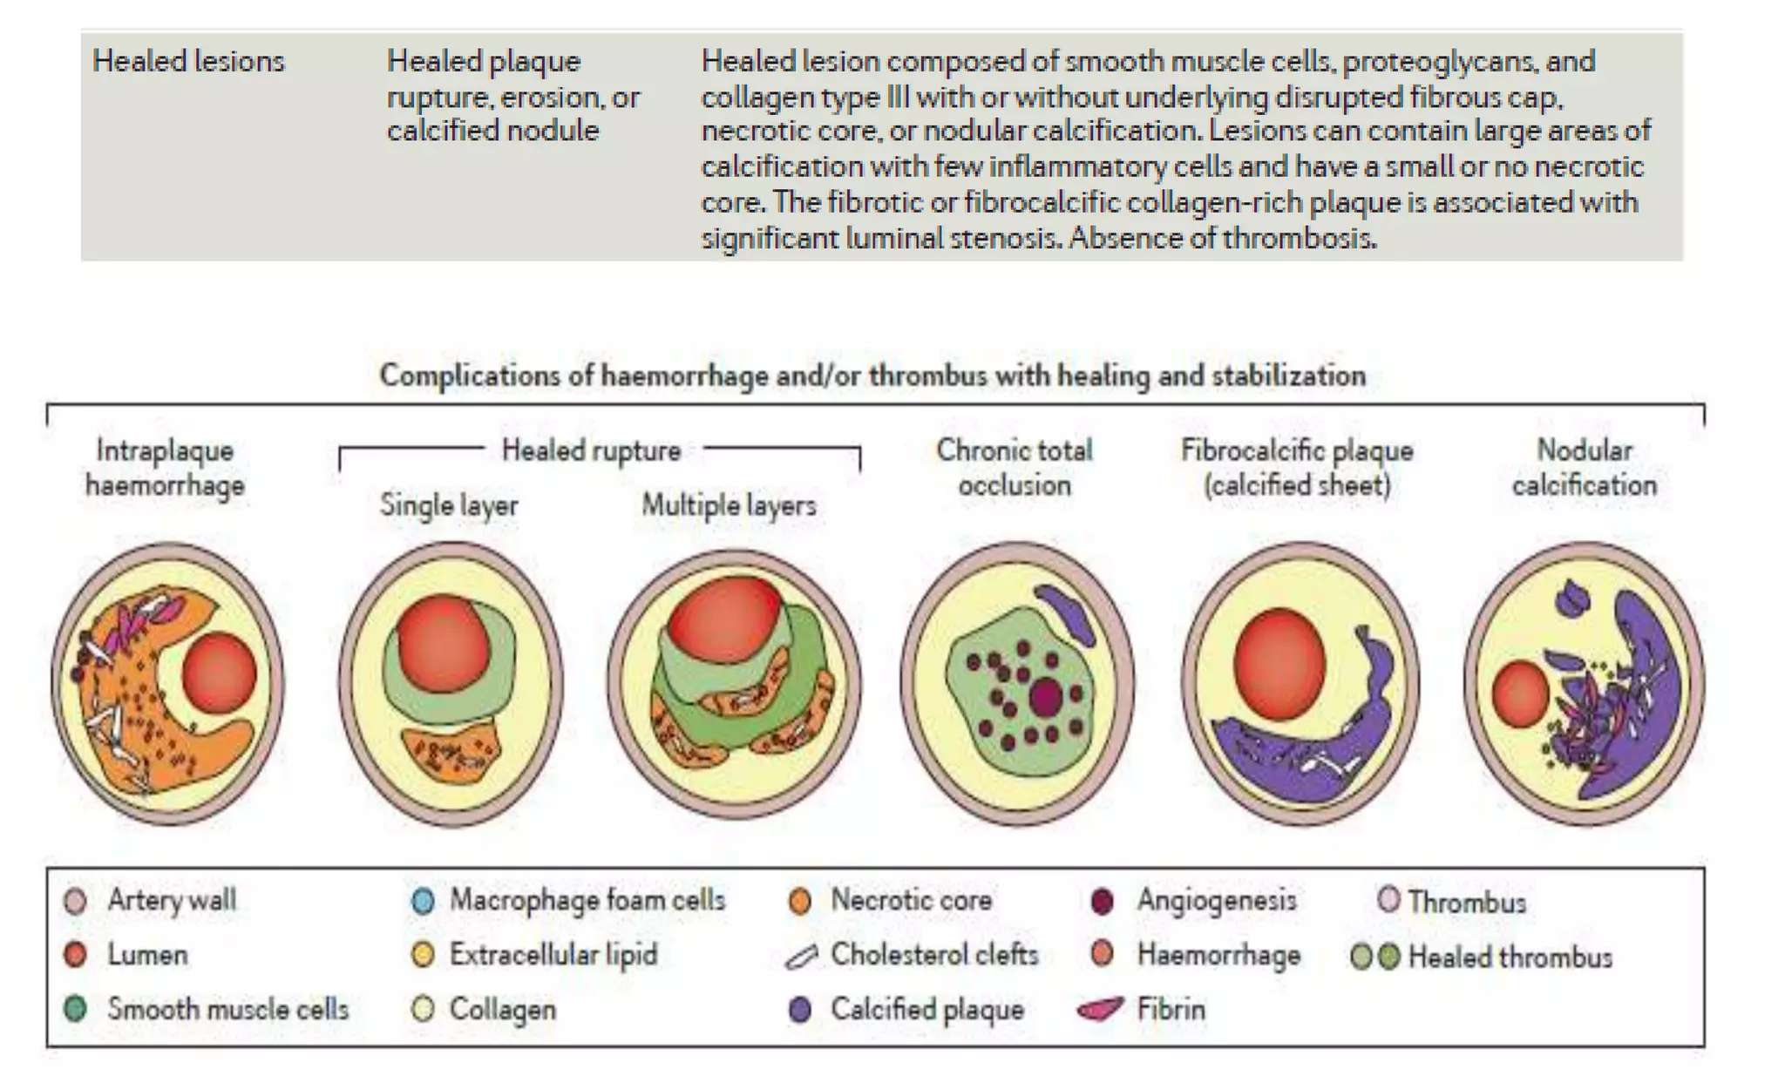

Slide 19
INITIATION OF ATHEROSCHLEROSIS
On initiation of an atherogenic diet, typically rich in cholesterol and saturated fat, small lipoprotein particles accumulate in the intima.

Slide 20
These lipoprotein particles bind to proteoglycan of the arterial intima and tend to coalesce into aggregates.
• Capture and retention of lipoproteins - prolonged residence time.
•increased susceptibility to oxidative or other chemical modifications- pathogenesis of early atherosclerosis.
• Contributors to oxidative stress in the nascent atheroma could include reduced (NADH/NADPH) oxidases expressed by vascular cells, lipoxygenases expressed by infiltrating leukocytes, or the enzyme myeloperoxidase.

Slide 24
LEUKOCYTE RECRUITMENT AND RETENTION
• The normal EC generally resists adhesive interactions with leukocytes. • Even in inflamed tissues, most recruitment and trafficking of leukocytes occurs in postcapillary venules and not in arteries.
• Very soon after initiation of hypercholesterolemia, however, leukocytes adhere to the endothelium and move between EC junctions, or even penetrate through ECs (transcytosis) to enter the intima, where they begin to accumulate lipids and become FOAM CELLS.

Slide 25
• In addition to the monocyte, T lymphocytes also tend to accumulate in early human and animal atherosclerotic lesions.
• The expression of certain leukocyte adhesion molecules on the surface of the EC regulates the adherence of monocytes and T cells to the endothelium.
• These include:
– Vascular Cell Adhesion molecule(VCAM-1) (Interacts with only those classes of leukocytes that accumulate in nascent atheroma-monocytes and T cells)
– P-Selectin
– Intercellular adhesion molecule-1(ICAM-1)
– E-Selectin

Slide 27
LEUCOCYTE PENETRATION
• Once adherent to the endothelium, leukocytes must receive a signal to penetrate the endothelial monolayer and enter the arterial wall.
• The current concept of directed migration of leukocytes involves the action of protein molecules known as chemoattractant cytokines or chemokines.
• Among the many chemokines implicated in atherogenesis, few are of particular interest in recruiting the mononuclear cells characteristic of the early atheroma.
– Monocyte chemoattractant protein 1(MCP-1)
– Fractalkine
– Chemoattractants induced by Interferon-gamma

Slide 28
Leucocyte retention
• The accumulation of monocytes in plaques depends not only on their recruitment, but also on their retention.
• Recent work has implicated netrin-1 interacting with its receptor UNC5b (both induced by hypoxia) as a protein that retards macrophages from exiting plaques.

Slide 29
INTRACELLULAR LIPID ACCUMULATION: FOAM CELL FORMATION
• The monocyte, once recruited to the arterial intima, can imbibe lipid and become a foam cell or lipid-laden macrophage.
• Although most cells can express the classic cell surface receptor for LDL, that receptor does not mediate foam cell accumulation.
• This is evident clinically, because tendinous xanthomas filled with foamy macrophages still develop in patients lacking functional LDL receptors (familial hypercholesterolemia homozygotes).
• The LDL receptor does not mediate foam cell formation, because of its exquisite regulation by cholesterol. As soon as a cell collects enough cholesterol for its metabolic needs from LDL capture, an elegant transcriptional control mechanism statisfy expression of the receptor.

Slide 30
WHAT MEDIATES EXCESSIVE LIPID UPTAKE OF MACROPHAGES?
• SCAVENGER RECEPTORS- These surface molecules, belonging to several families, bind modified rather than native lipoproteins and participate in their internalization.
• CD36
• MACROSIALIN

Slide 31
Up to this point in the development of the nascent atheroma, the lesion consists primarily of lipid- engorged macrophages.
Complex features such as fibrosis, thrombosis, and calcification do not characterize the fatty streak, the precursor lesion of the complex atheroma.
Several lines of evidence suggest that such fatty streaks can regress, at least to some extent.

Slide 32
EVOLUTION OF ATHEROMA- ROLE OF SMCs
• subsequent evolution of atheroma into more complex plaques also involves SMCs.
• SMCs in the normal arterial tunica media differ considerably from those in the intima of an evolving atheroma.
• Some SMCs probably arrive in the arterial intima early in life; others accumulate in advancing atheroma after recruitment from the underlying media into the intima or arise from blood-borne precursors.
Notes:
The early events in atheroma initiation involve primarily altered endothelial function and recruitment and accumulation of leukocytes, the

Slide 33
The accumulation of SMCs during atherosclerosis and growth of the intima does not occur in a continuous and linear fashion.
• Bursts of SMC replication may occur during the life history of a given atheromatous lesion.
• Episodes of plaque disruption with thrombosis may expose SMCs to potent mitogens, including the coagulation factor thrombin itself. This results in bursts of smooth muscle activity.

Slide 34
SMOOTH MUSCLE CELL DEATH DURING ATHEROGENESIS
Some SMCs in advanced human atheroma exhibit programmed cell death or apoptosis.
Apoptosis may occur in response to inflammatory cytokines present in the evolving atheroma.
In addition to soluble cytokines that may trigger programmed cell death, T cells in atheroma may participate in eliminating some SMCs.
Thus SMC accumulation in the growing atherosclerotic plaque probably results from a tug-of-war between cell replication and cell death
Notes:
• In addition to SMC replication, death of these cells also may participate in complication of the atherosclerotic plaque.

Slide 35
ARTERIAL EXTRACELLULAR MATRIX
• Extracellular matrix, rather than cells themselves, makes up much of the volume of an advanced atherosclerotic plaque.
• The major extracellular matrix macromolecules that accumulate in atheroma include interstitial collagens (types I and III) and proteoglycans such as versican, biglycan, aggrecan, and decorin.
• Elastin fibers also may accumulate in atherosclerotic plaques.
• Arterial SMCs produce these matrix molecules in disease, just as they do during development and maintenance of the normal artery.
• Stimuli for excessive collagen production by SMCs include platelet-derived growth factor (PDGF) and TGF-β.

Slide 36
• Much as with the accumulation of SMCs, extracellular matrix secretion also depends on a balance, as noted earlier.
• In this case, the counterpoise to biosynthesis of the extracellular matrix molecules is breakdown catalyzed in part by catabolic enzymes, notably the matrix metalloproteinases (MMPs).
• Dissolution of extracellular matrix macromolecules undoubtedly contributes to the migration of SMCs as they penetrate into the intima from the media through a dense extracellular matrix, traversing the elastin-rich internal elastic lamina.

Slide 37
Extracellular matrix breakdown also likely plays a role in arterial remodeling that accompanies lesion growth.
• During the early life of an atheromatous lesion, plaques grow outwardly, in an abluminal direction, rather than inwardly, in a way that would lead to luminal stenosis.
• This outward growth of the intima leads to an increase in the caliber of the entire artery. This so-called positive remodeling or compensatory enlargement must involve turnover of extracellular matrix molecules to accommodate the circumferential growth of the artery.
• Luminal stenosis tends to occur only after the plaque burden exceeds some 40% of the cross-sectional area of the artery.

Slide 38
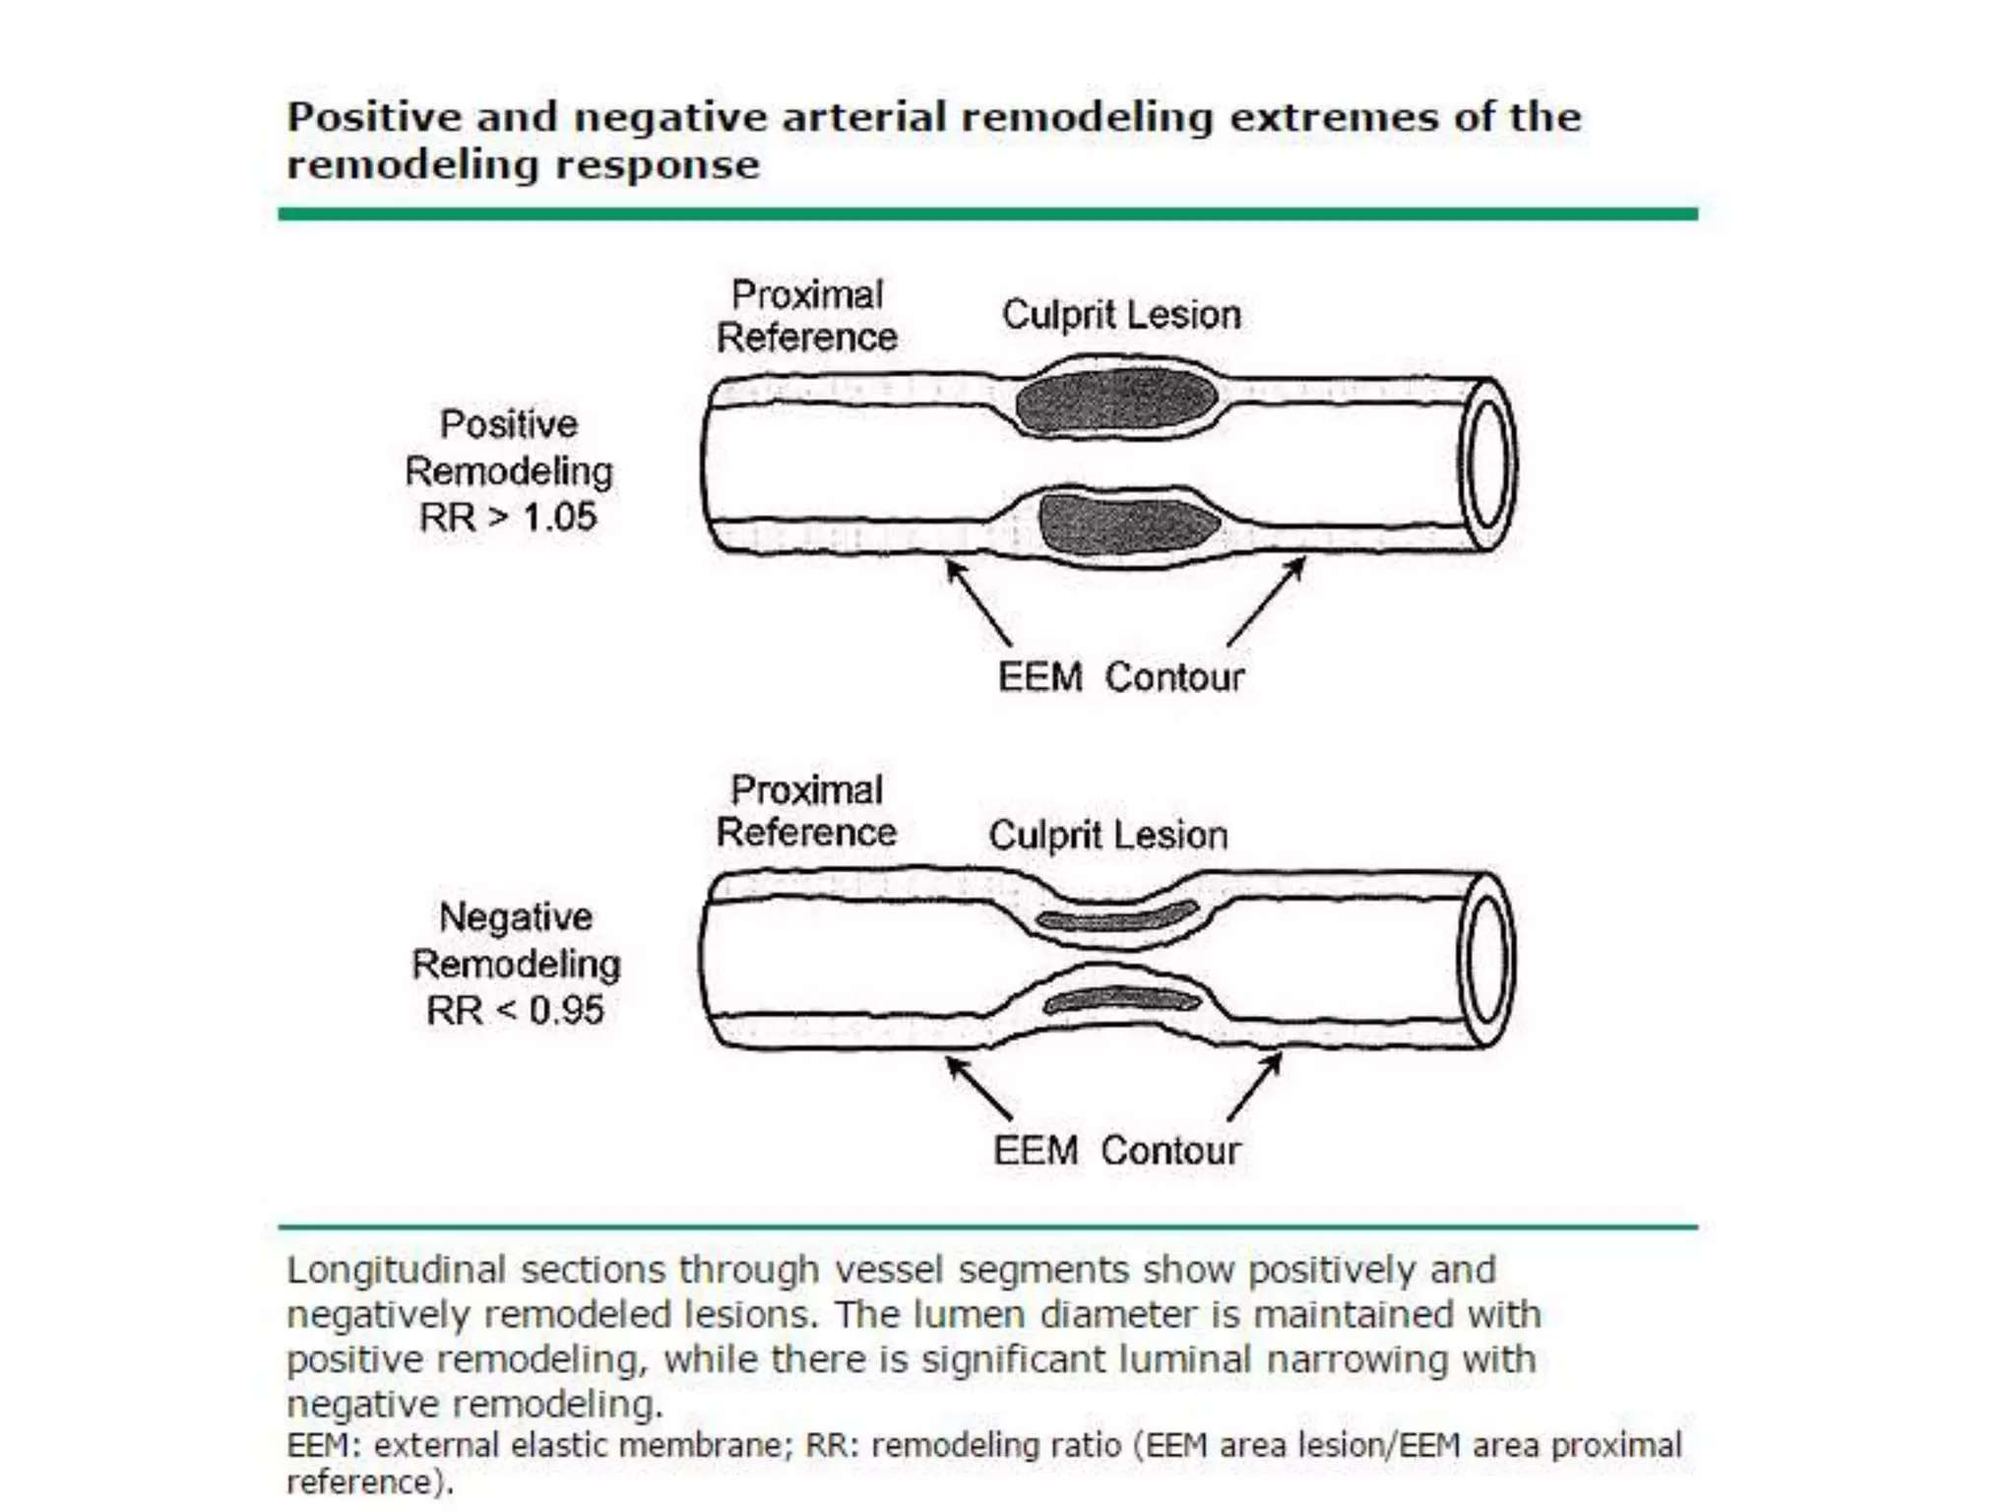

Slide 39
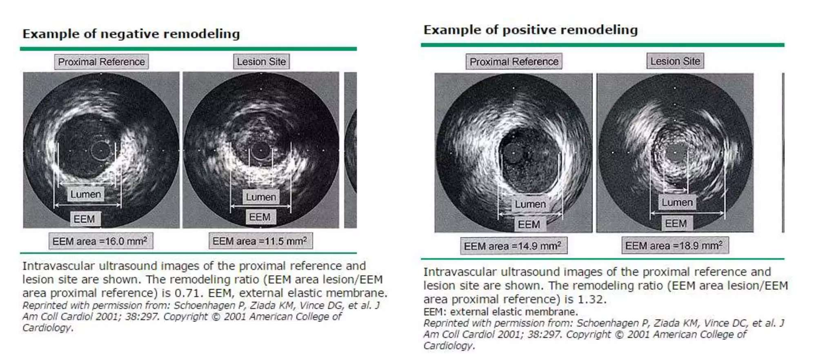

Slide 40
ANGIOGENESIS IN PLAQUES
• Develops microcirculation as they grow, because of endothelial migration and replication.
• Rich neovascularization in evolving plaques.
• These microvessels probably form in response to angiogenic peptides overexpressed in atheroma.
• These angiogenesis factors include vascular endothelial growth factor (VEGF) forms of fibroblast growth factors, placental growth factor (PlGF), and oncostatin M

Slide 41
Significance of Angiogenesis of plaques
• provide a relatively large surface area for the trafficking of leukocytes,. In the advanced human atherosclerotic plaque, microvascular endothelium displays mononuclear cell–selective adhesion molecules such as VCAM-1 much more prominently than does the macrovascular endothelium overlying the plaque.
• may allow growth of the plaque, overcoming diffusion limitations on oxygen and nutrient supply.
• Finally, the plaque microvessels may be friable and prone to rupture like the neovessels in the diabetic retina.
• Hemorrhage and thrombosis in situ could promote a local round of SMC proliferation and matrix accumulation in the area immediately adjacent to the microvascular disruption
Notes:
• These microvessels within plaques probably have considerable functional significance.

Slide 42
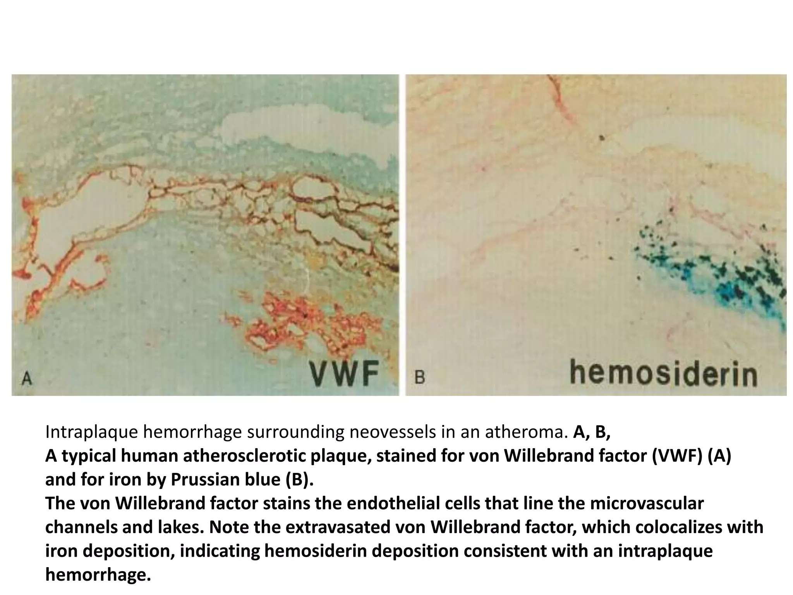

Slide 43
PLAQUE MINERALIZATION
• Plaques often develop areas of calcification as they evolve.
• Some subpopulations of SMCs may foster calcification by enhanced secretion of cytokines such as bone morphogenetic proteins, homologues of TGF-β.
• Receptor activator of NF-κB ligand (RANKL), a member of the tumor necrosis factor family, appears to promote SMC mineral formation through a bone morphogenetic protein 4 (BNP4)– dependent pathway.
• The transcription factor Runx-2, activated by inflammatory mediators and oxidative stress among other stimuli, can promote SMC mineral formation by activating AKT (i.e., protein kinase B)
• Microparticles elaborated by macrophages may provide niduses for plaque calcification, yielding another link between inflammatory cells and cardiovascular calcification

Slide 44
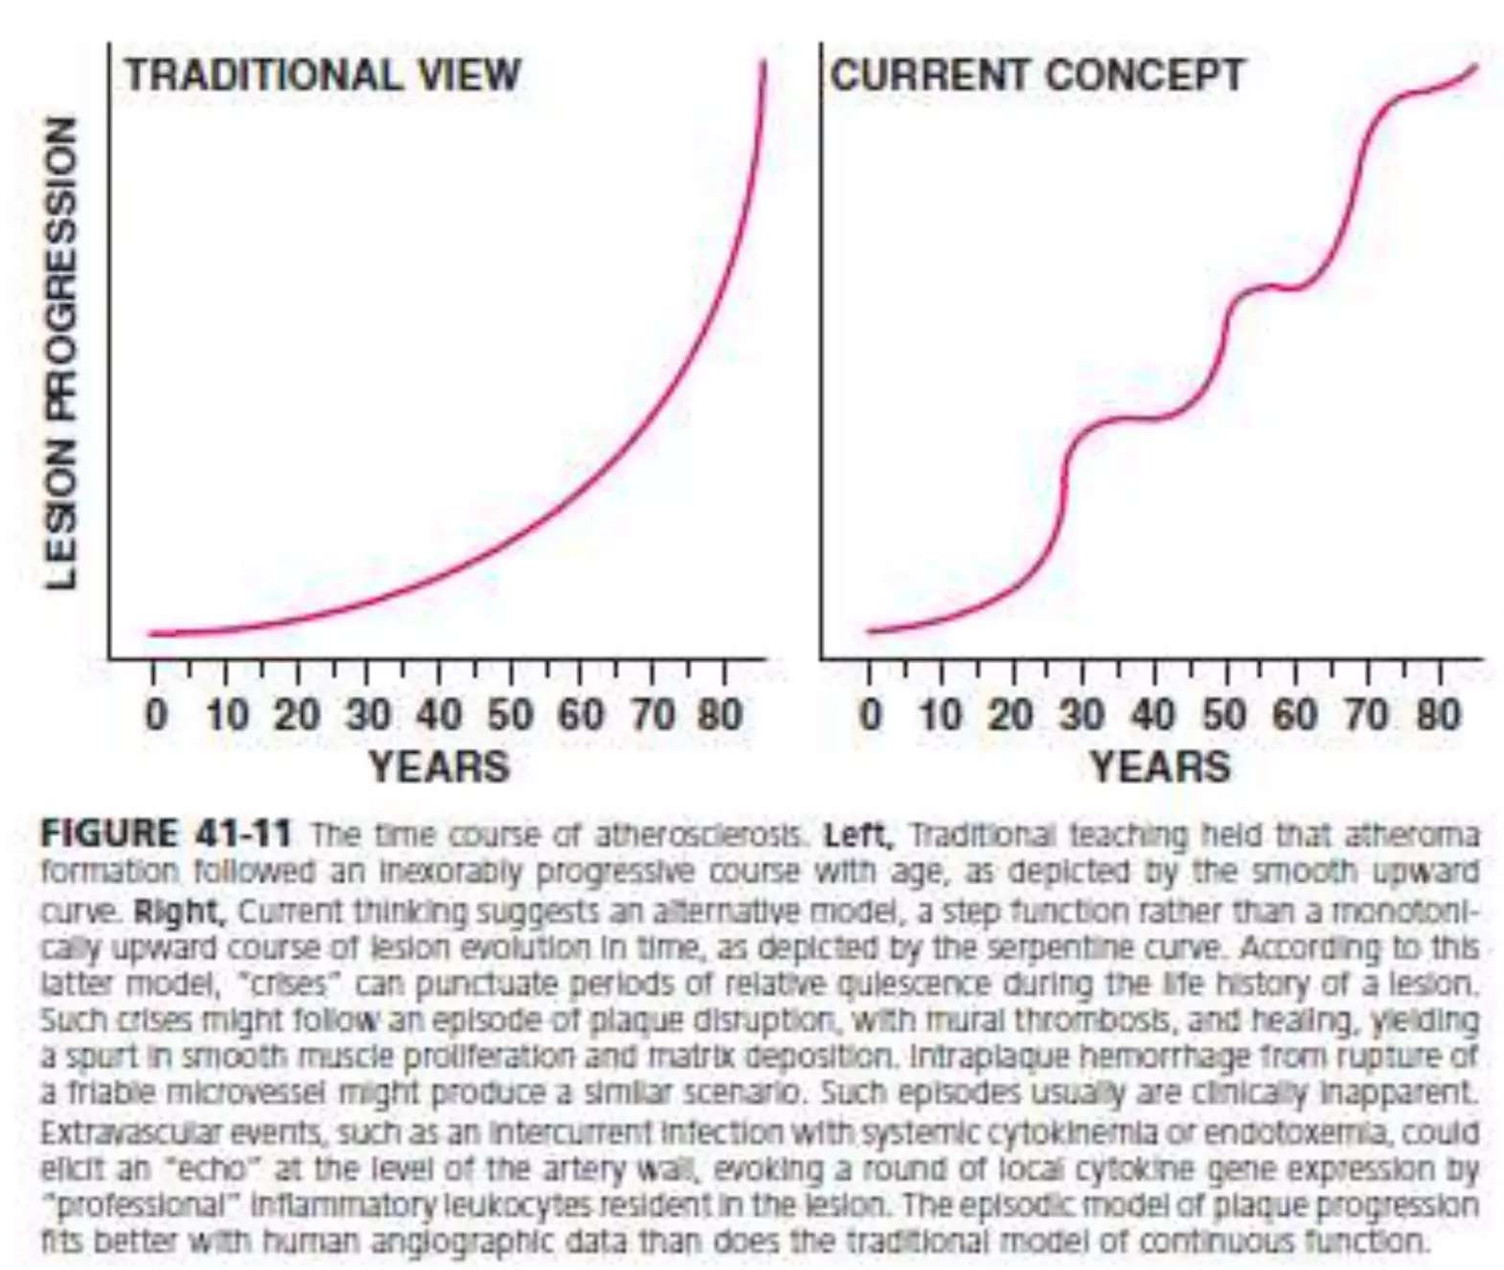
COMPLICATIONS OF ATHEROSCHLEROSIS

Slide 45
initiation and evolution of the atherosclerotic plaque generally last many years, during which the affected person often has no symptoms.
• After the plaque burden exceeds the capacity of the artery to remodel outward, encroachment on the arterial lumen begins.
• During the chronic asymptomatic or stable phase of lesion evolution, growth probably occurs discontinuously, with periods of relative quiescence punctuated by episodes of rapid progression.

Slide 46
Human angiographic studies support this discontinuous growth of coronary artery stenoses.
• Eventually, the stenoses may progress to a degree that impedes blood flow through the artery. Lesions that produce stenoses of greater than 70% can cause flow limitations under conditions of increased demand.
• This type of athero-occlusive disease commonly produces chronic stable angina pectoris or intermittent claudication on increased demand.
• Thus the symptomatic phase of atherosclerosis usually begins many decades after lesion initiation.

Slide 47
• In many cases of myocardial infarction, however, no history of previous stable angina heralds the acute event.
•Many myocardial infarctions result not from high-grade stenoses but from lesions that do not limit flow.
• Acute coronary syndromes often result from thrombi that form as a consequence of disruption of plaques that do not produce a critical stenosis.
• Indeed, culprit lesions of acute myocardial infarction may be sizable; but they may not produce a critical luminal narrowing because of compensatory enlargement.
• Critical stenoses do cause myocardial infarctions, and high-grade stenoses are more likely to cause acute myocardial infarction than are nonocclusive lesions; yet because the noncritical stenoses by far outnumber the tight focal lesions in a given coronary tree, the lesser stenoses cause more infarctions, even though high-grade stenoses have a greater individual probability of causing infarction.

Slide 48
THROMBOSIS AND ATHEROMA COMPLICATION
• 2 MAJOR MODES OF PLAQUE DISRUPTION PROVOKE MOST CORONARY THROMBI :
–PLAQUE RUPTURE (rupture of plaque’s fibrous cap) 75%
–SUPERFICIAL PLAQUE EROSION 25%

Slide 49
PLAQUE RUPTURE AND THROMBOSIS
• IMBALANCE BETWEEN MECHANICAL STRENGTH OF THE FIBROUS CAP AND THE FORCES THAT IMPINGE ON IT.
• Interstitial forms of collagen provide most of the biomechanical resistance to disruption of the fibrous cap. Hence the metabolism of collagen probably participates in regulating the propensity of a plaque to rupture.
• Factors that decrease collagen synthesis by SMCs can impair their ability to repair and to maintain the plaque’s fibrous cap.
SO IF THE FACTORS THAT DEGRADE COLLAGEN OUTWEIGH THE FACTORS RESPONSIBLE FOR ITS PRODUCTION ------IT WILL RESULT IN A THIN CAP FIBROATHEROMA (previously called VULNERABLE PLAQUE)

Slide 50
• A RELATIVE LACK OF SMCs secondary to INFLAMMATORY MEDIATORS IS ALSO RESPONSIBLE.
• PROMINENT ACCUMULATION OF MACROPHAGES WITH A LARGE LIPID POOL is also responsible

Slide 51
PROMINENT ACCUMULATION OF MACROPHAGES WITH A LARGE LIPID POOL
• From a strictly biomechanical viewpoint, a large lipid pool can serve to concentrate biomechanical forces on the shoulder regions of plaques, where they frequently fracture.
• From a metabolic standpoint, the activated macrophage characteristic of the plaque’s core region produces the cytokines and the matrix-degrading enzymes thought to regulate aspects of matrix catabolism and SMC apoptosis in turn.
• Apoptotic macrophages and SMCs can generate particulate tissue factor, a potential instigator of microvascular thrombosis after spontaneous or iatrogenic plaque disruption.
• The success of lipid-lowering therapy in reducing the incidence of acute myocardial infarction or unstable angina in patients at risk may result from a reduced accumulation of lipid and a decrease in inflammation and plaque thrombogenicity.

Slide 53
THROMBOSIS DUE TO SUPERFICIAL EROSION OF PLAQUES
• In humans, superficial erosion appears more likely to cause fatal acute myocardial infarction in women and in persons with hypertriglyceridemia and diabetes mellitus, but the underlying molecular mechanisms remain obscure.
• VARIOUS POSSIBLE MECHANISMS OF ENDOTHELIAL DAMAGE:
1.Apoptosis of ECs could contribute to desquamation of ECs in areas of superficial erosion.
2.Likewise, MMPs, such as certain gelatinases specialized in degrading the nonfibrillar collagen found in the basement membrane (e.g., collagen type IV), also may sever the tetherings of the EC to the subjacent basal lamina and promote their desquamation.
3.Vasospasm of atherosclerotic coronary arteries in rabbits can promote endothelial damage, thrombosis, and myocardial infarction

Slide 54
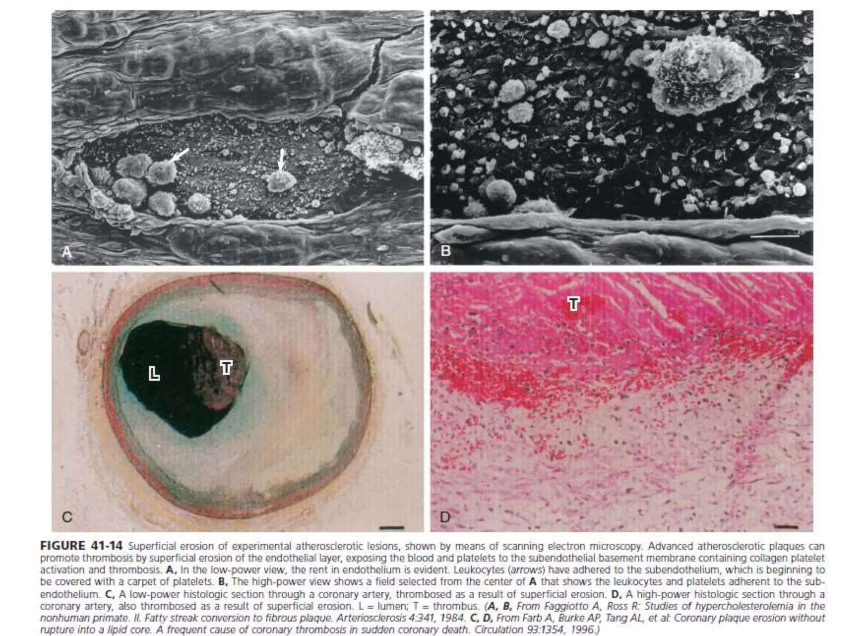

Slide 55
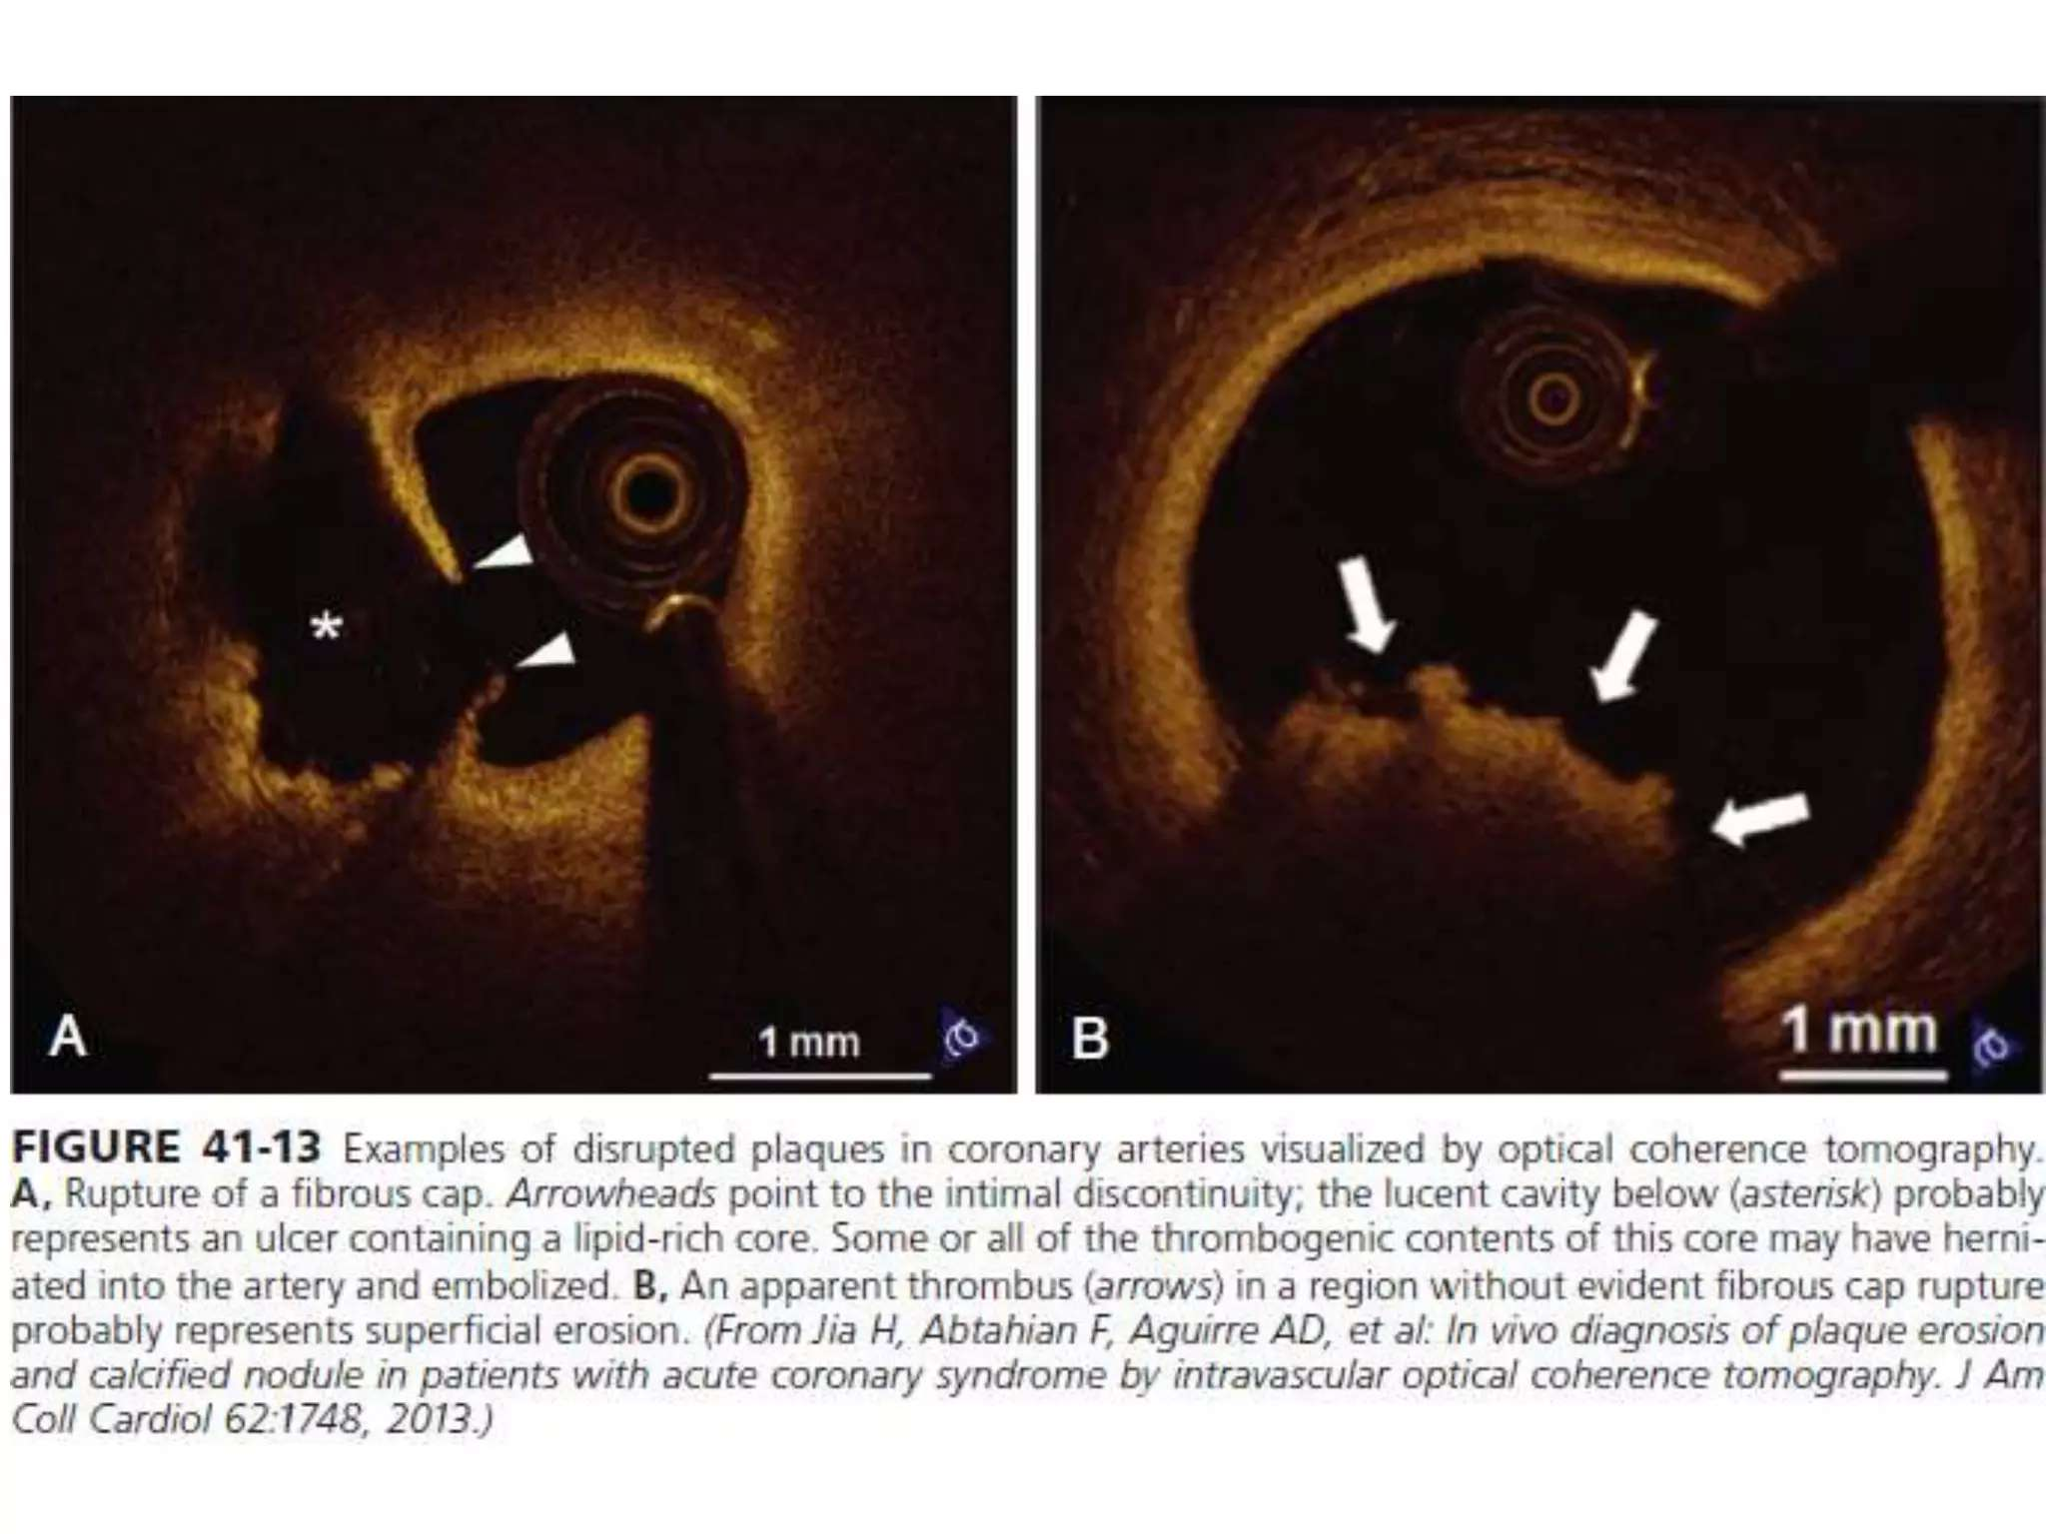

Slide 56
DO ALL PLAQUE DISRUPTIONS CAUSE ACS/ARTERIAL OCCLUSION?
• Most plaque disruptions do not give rise to clinically apparent coronary events.
• Careful pathoanatomic examination of hearts obtained from patients who have succumbed to noncardiac death has shown a surprisingly high incidence of focal plaque disruptions with limited mural thrombi.
• Moreover, hearts fixed immediately after explantation from persons with severe but chronic stable coronary atherosclerosis who had undergone transplantation for ischemic cardiomyopathy show similar evidence for ongoing but asymptomatic plaque disruption

Slide 57
• Experimentally, in atherosclerotic nonhuman primates, mural platelet thrombi can complicate plaque erosions without causing arterial occlusion.
• Therefore repetitive cycles of plaque disruption, thrombosis in situ, and healing probably contribute to lesion evolution and plaque growth.
• The “burned-out” fibrous and calcific atheroma may represent a Healed plaque with rupture and thrombosis.
• Such episodes of thrombosis and healing constitute one type of crisis in the history of a plaque that may cause a burst of SMC proliferation, migration, and matrix synthesis
Plaque disruptions with healing underlie many thrombi that cause sudden death, indicating that nonocclusive thrombosis may precede the fatal event more frequently than has been previously recognized

Slide 58
Notes:
Thrombosis depends not only on the “solid state” of the plaque that may rupture or erode to trigger thrombosis but also on the “fluid phase” of blood that determines the consequences of a given plaque disruption. The amount of tissue factor in the lipid core of a plaque (the solid state) can control the degree of clot formation that will ensue after disruption. The level of fibrinogen in the fluid phase of blood can influence whether a plaque disruption will cause an occlusive thrombus that can precipitate an acute ST- segment elevation myocardial infarction or yield merely a small mural thrombus. Likewise, elevated levels of inhibitors of fibrinolysis, such as plasminogen activator inhibitor 1 (PAI-1), will impede the ability of endogenous thrombolytic enzymes to limit thrombus growth or persistence.

Slide 59
Why atherosclerosis manifests as stenosis/aneurysms(directionally opposite manners)??
• Atherosclerosis mostly causes stenosis in the coronaries while ectasia of the abdominal aorta? WHY?
• Histologic examination shows considerable distinction between occlusive atherosclerotic disease and aneurysmal disease. In typical coronary artery atherosclerosis, expansion of the intimal lesion produces stenotic lesions. The tunica media underlying the expanded intima often is thinned, but its general structure remains relatively well preserved.
• By contrast, transmural destruction of the arterial architecture occurs in aneurysmal disease.
• In particular, the usually well-defined laminar structure of the normal tunica media disappears with obliteration of the elastic laminae. The medial SMCs, usually well preserved in typical stenotic lesions, are notable for their paucity in the media of advanced aortic aneurysms.

Slide 60
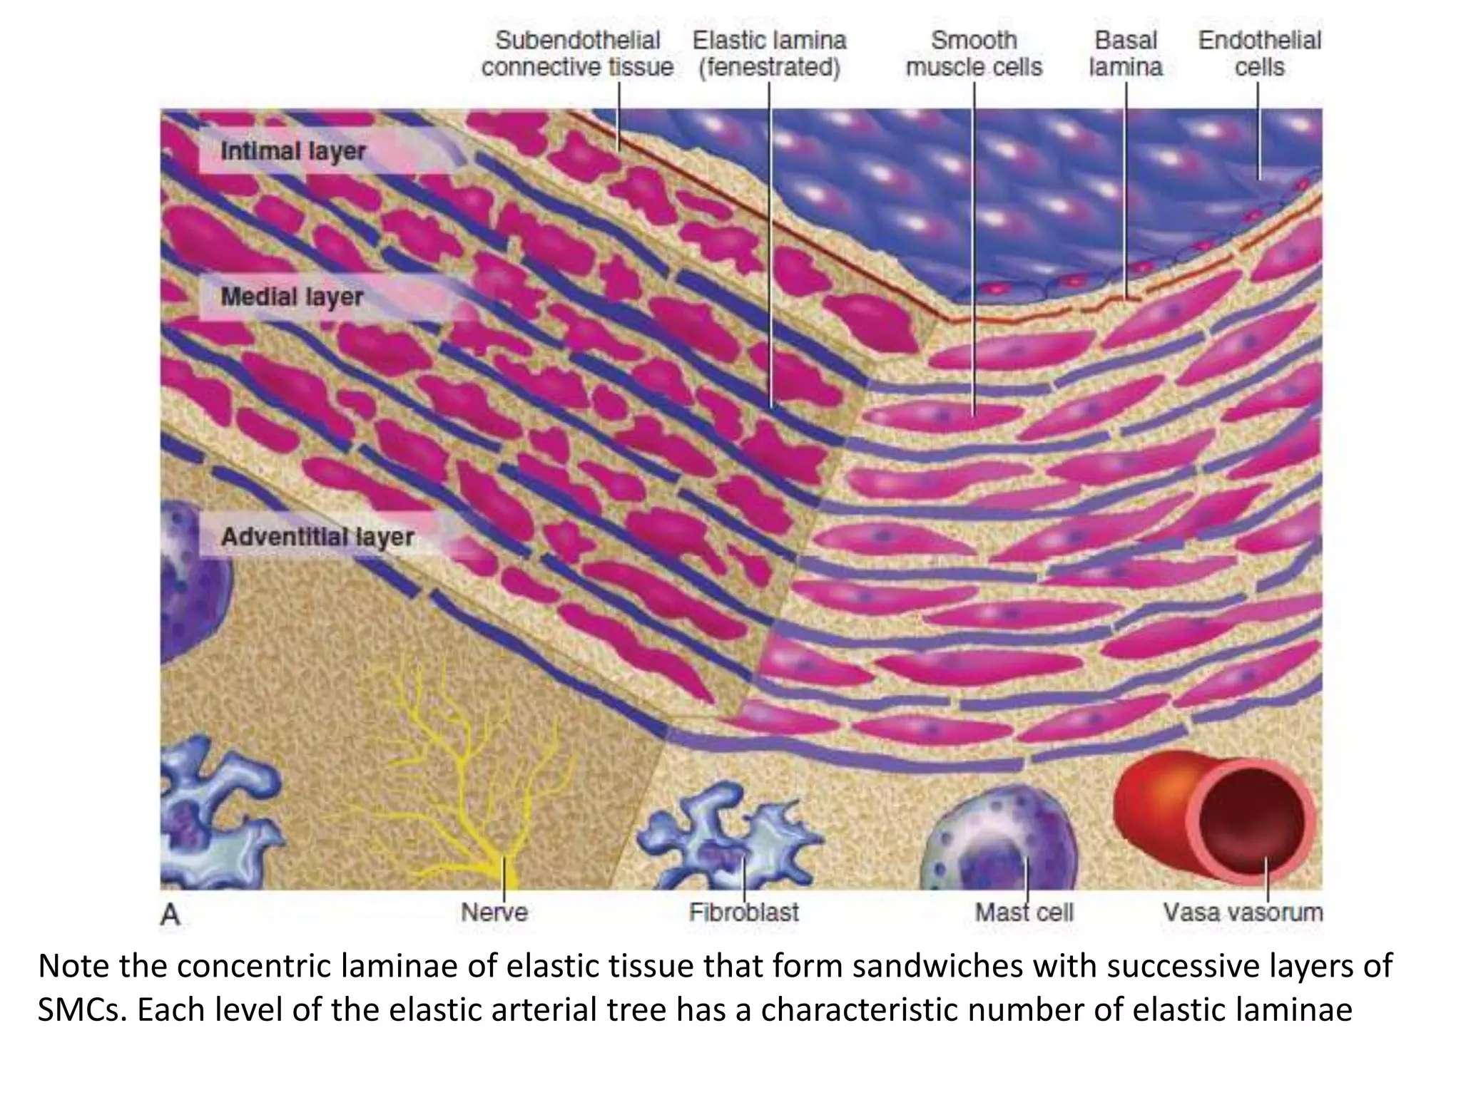

Slide 61
PATHOPHYSIOLOGY IS STILL OBSCURE.
• Widespread destruction of the elastic laminae suggests a role for degradation of elastin, collagen, and other constituents of the arterial extracellular matrix.
• Many studies have documented overexpression of matrix-degrading proteinases, including MMPs, in human aortic aneurysm specimens. Clinical trials are testing the hypothesis that MMP inhibitors can reduce the expansion of aneurysms.
• In atherosclerotic mice, angiotensin II potentiates aneurysm formation. Alterations in TGF-β signaling can predispose to aneurysm formation. Mutations in TGF-β receptors can cause arterial ectasia.
• Thus heightened elastolysis may explain the breakdown of the usually ordered structure of the tunica media in this disease.
• Although extracellular matrix degradation and SMC death also occur in sites where atherosclerosis causes stenosis, they appear to predominate in regions of aneurysm formation and to affect the tunica media much more extensively, for reasons that remain obscure.

Slide 62
INFRARENAL AORTA IS HIGHLY PRONE TO THE DEVELOPMENT OF ATHEROSCLEROSIS? WHY?
• the dorsal surface of the infrarenal abdominal aorta has a particular predilection for the development of fatty streaks and raised lesions in Americans younger than 35 years of age who succumbed for noncardiac reasons .
• Because of the absence of vasa vasorum, the relative lack of blood supply to the tunica media in this portion of the abdominal aorta might explain the regional susceptibility of this portion of the arterial tree to aneurysm formation.
• In addition, the lumbar lordosis of the biped human may alter the hydrodynamics of blood flow in the distal aorta, yielding flow disturbances that may promote lesion formation

Slide 63
Comparison of atherosclerotic processes In native vessel, vein grafts and in-stent neoatherosclerosis
• Restenosis Vs Instent stenosis
• In-stent atherosclerosis or ‘neoatherosclerosis’ is histologically identified by the lipid-laden foamy macrophages with or without complications of a necrotic core and/or calcification within the nascent intima.
• In all cases, necrotic cores of neoatherosclerosis do not communicate with the underlying native plaque.
• Clusters of macrophage-derived foam cells within the peristrut regions, or near the luminal surface, are the most- frequent and earliest lesion of neoatherosclerosis.

Slide 64
•Vein-graft atherosclerosis and in-stent neoatherosclerosis develop over a period of months to a few years.
• This temporal difference might reflect the morphological diversity relative to the natural history of progression among these entities.
• Adaptive intimal thickening in native arteries within the first year after stent implantation parallels the neointimal hyperplasia observed in vein grafts

Slide 65
• SMC proliferation without macrophage foam cell infiltration is frequently observed in BMS implants, especially in those aged <5 years.
• The most recognized feature of atherosclerosis common to vein grafts and stents is macrophage infiltration, which best resembles ‘fatty streaks’.
• Rather than individual foam cells interspersed throughout the intima, macrophages in vein grafts and stents have a tendency to accumulate as surface clusters or in peristrut regions, which is different from native disease.

Slide 66
• Another important distinction is that intimal xanthomas or ‘fatty streaks’ in native arteries might regress and are considered nonprogressive lesions, whereas foamy macrophage clusters in stents or SVGs seem to progress to form necrotic cores through cell death.
• In native coronary disease, pathological intimal thickening with lipid pools are common and considered a passageway to lesion progression; however, pathological intimal thickening is rarely present in vein grafts or DES, but can be seen in BMS.

Slide 67
In native disease, lipid pools and necrotic cores are localized to the deep intimal layers. The necrotic cores in neoatherosclerosis are more frequently superficial and, consequently, rarely present as early fibroatheromas; they instead occur as late fibroatheromas or, in some cases, TCFAs.
• Typical SVG atherosclerosis is often concentric and diffuse, with a ill defined fibrous cap than in native coronary disease; the cap seems fragile and vulnerable to rupture

Slide 68
• Coronary thrombi in neoatherosclerosis are primarily associated with plaque rupture
• in-stent erosions are rarely observed in BMS and DES, although erosions in this setting might not always be directly tied to the entity of neoatherosclerosis.
• Plaque erosion in vein grafts is a rare event and has been mostly observed at distal anastomotic sites.
• chronic total occlusion lesions consisting of organized thrombi within the stent can originate from plaque rupture associated with neoatherosclerosis in addition to thrombi that develop as a consequence of incomplete healing of the stent.

Slide 69
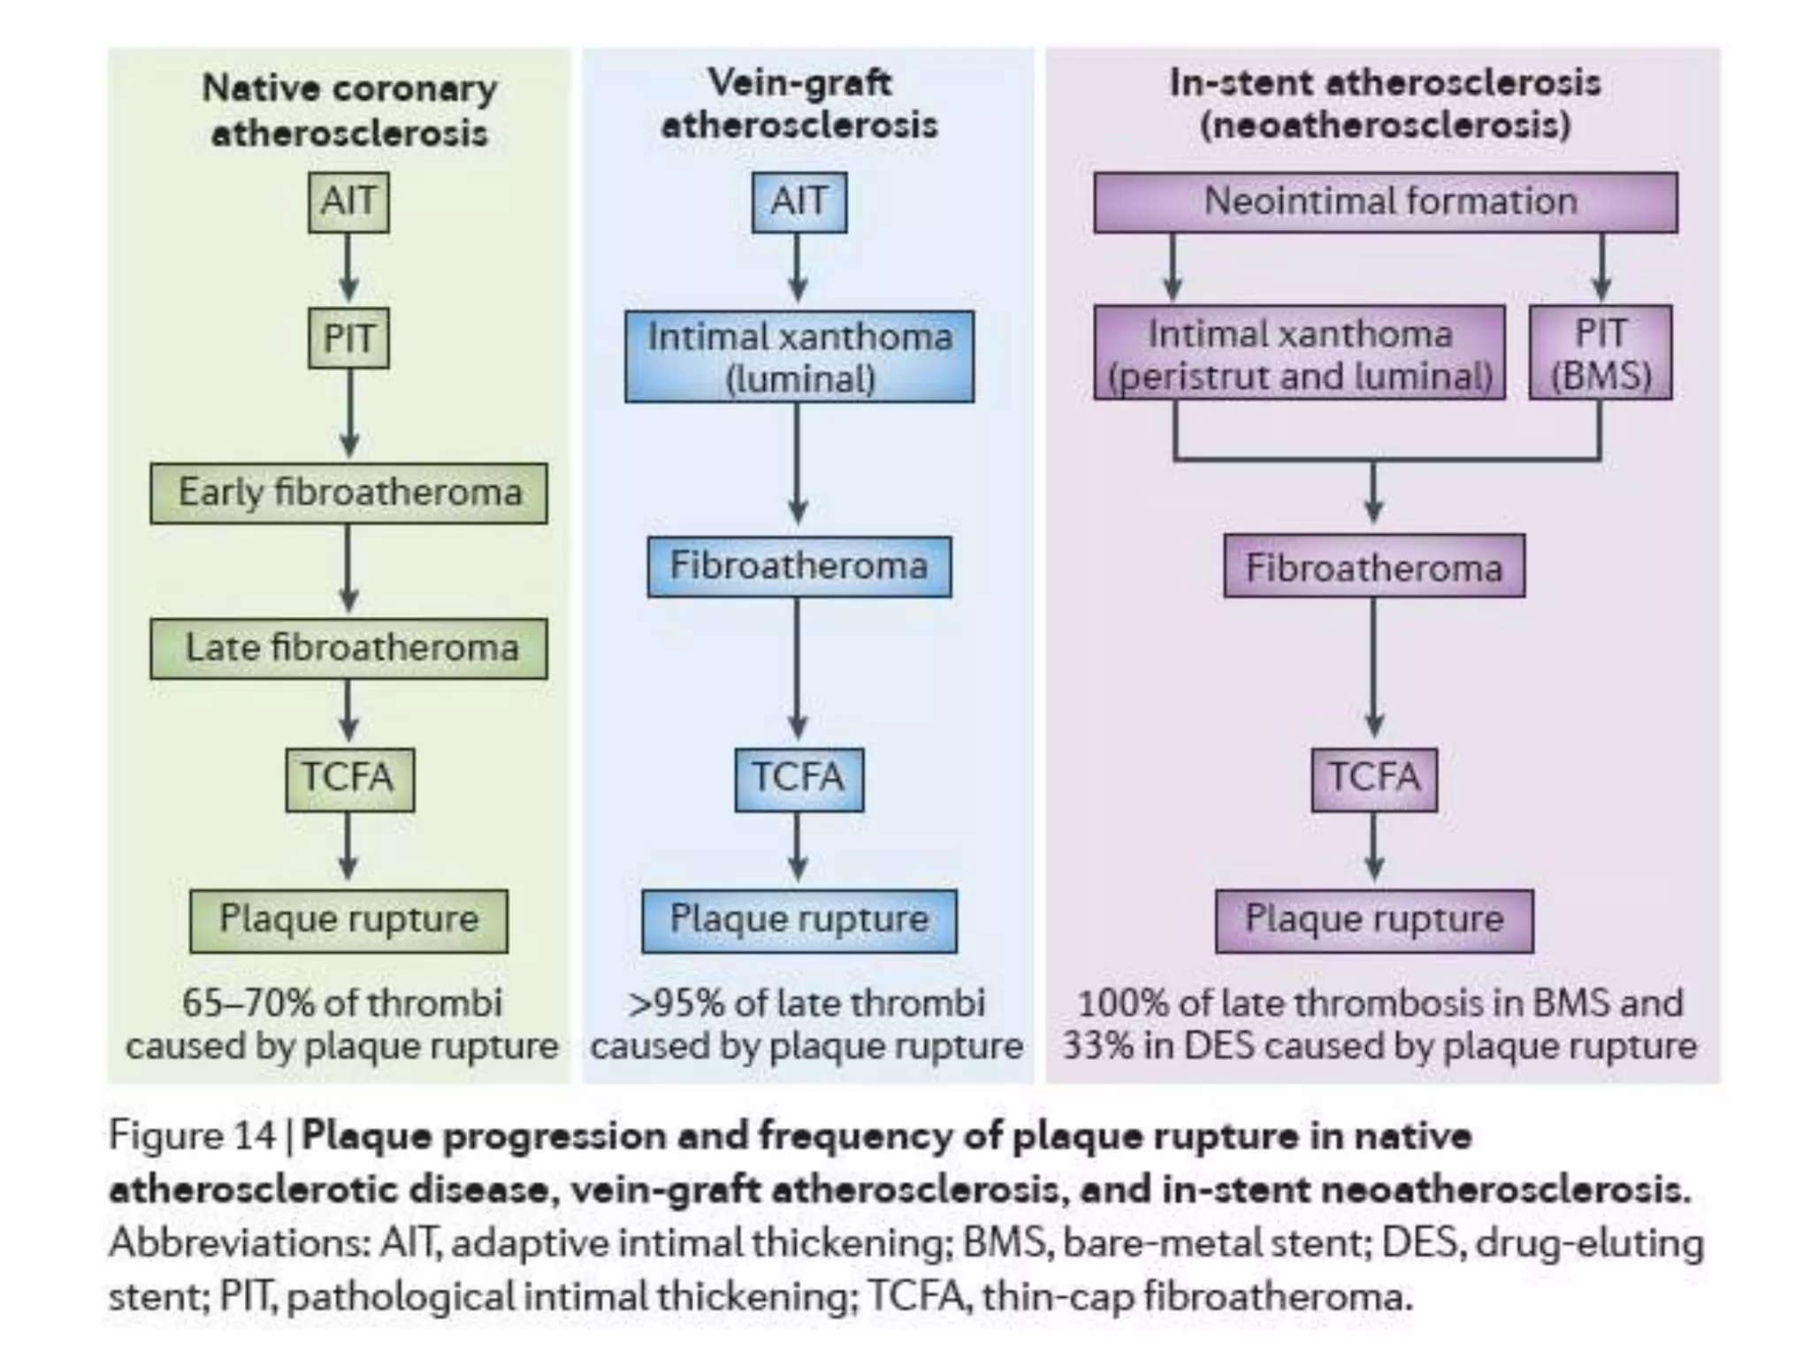

Slide 70
CONCLUSIONS
• Natural causes of luminal thrombosis in native coronary disease predominantly occur from plaque rupture, but also occur as a result of erosion.
• Precursor lesion of plaque rupture, identified as ‘vulnerable plaque’ or ‘TCFA’, seems an appropriate target for interventional treatment irrespective of the extent of luminal narrowing.

Slide 71
Accelerated atherosclerosis in SVGs or occurring within stents (known as ‘neoatherosclerosis’) is typically identified by macrophage foam cell infiltration, intraplaque haemorrhage, and a thin fibrous cap.
• Apoptosis of lipid-rich macrophages is thought to give rise directly to necrosis in accelerated disease, rather than transitioning through pathological intimal thickening, as occurs in native disease.
• Within the past 5 years, neoatherosclerosis has been identified as a contributing factor to late thrombosis attributed to percutaneous coronary intervention with stents. The incidence of neoatherosclerosis is more frequent and rapid in DES than in BMS.

Slide 72
Thank You!

